Slide 1

Reproducibility in an Office World
Noam Ross
@noamross
New York R Conference
May 2019

Slide 2


@EcoHealthNYC
@rOpenSci

Slide 3
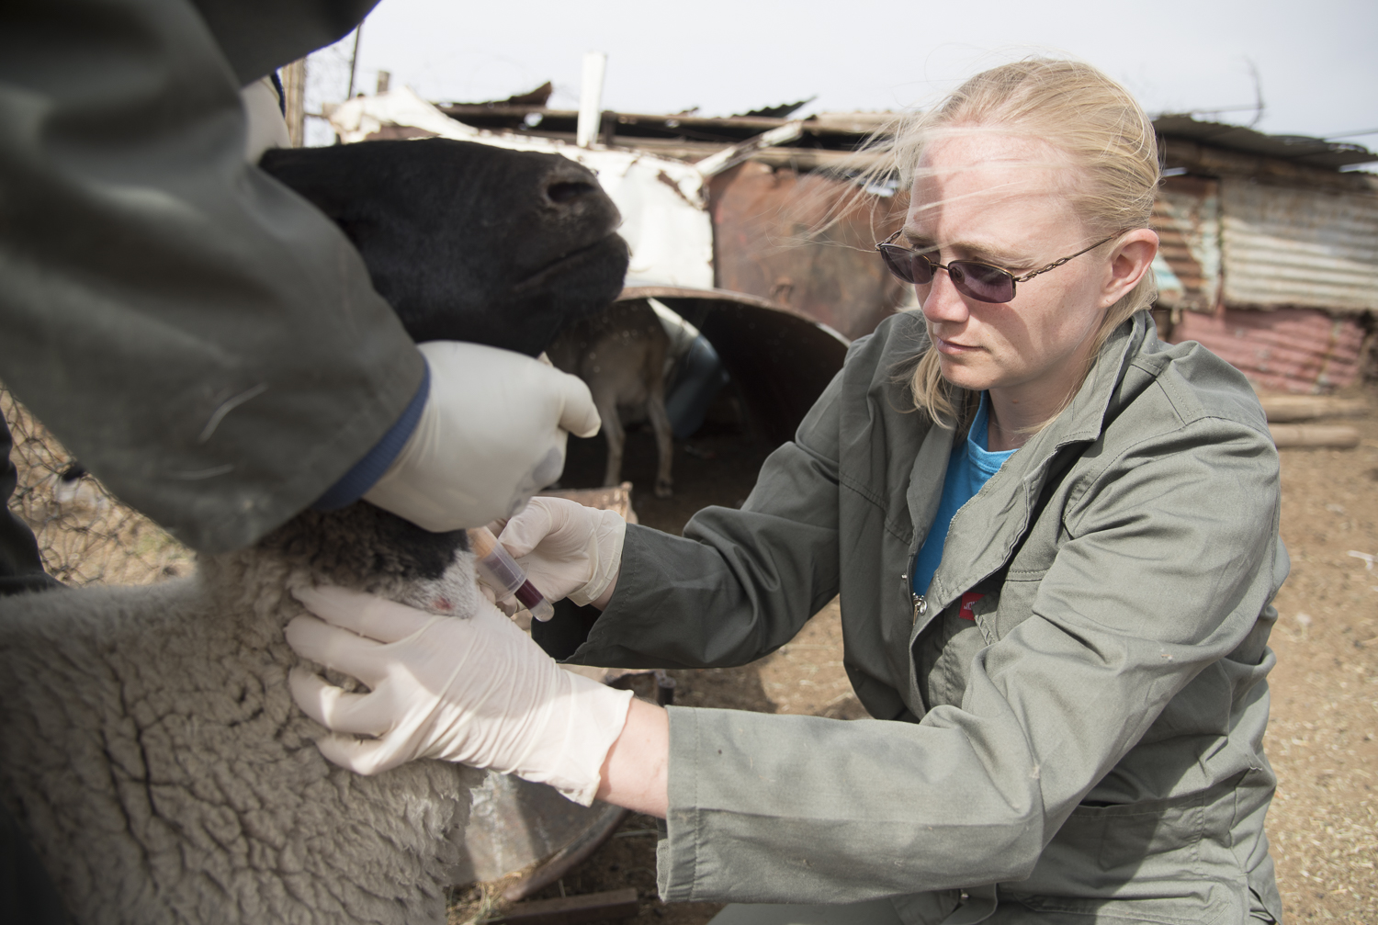
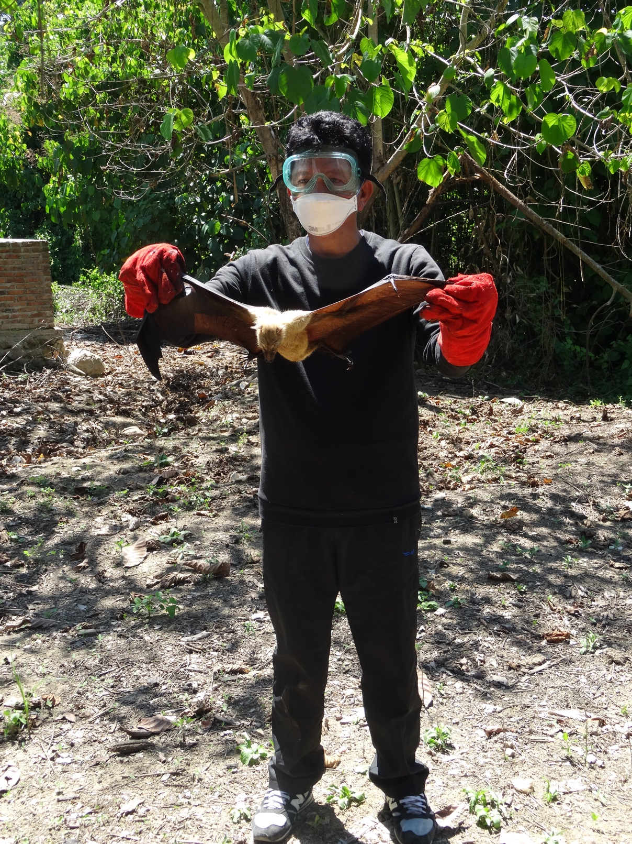
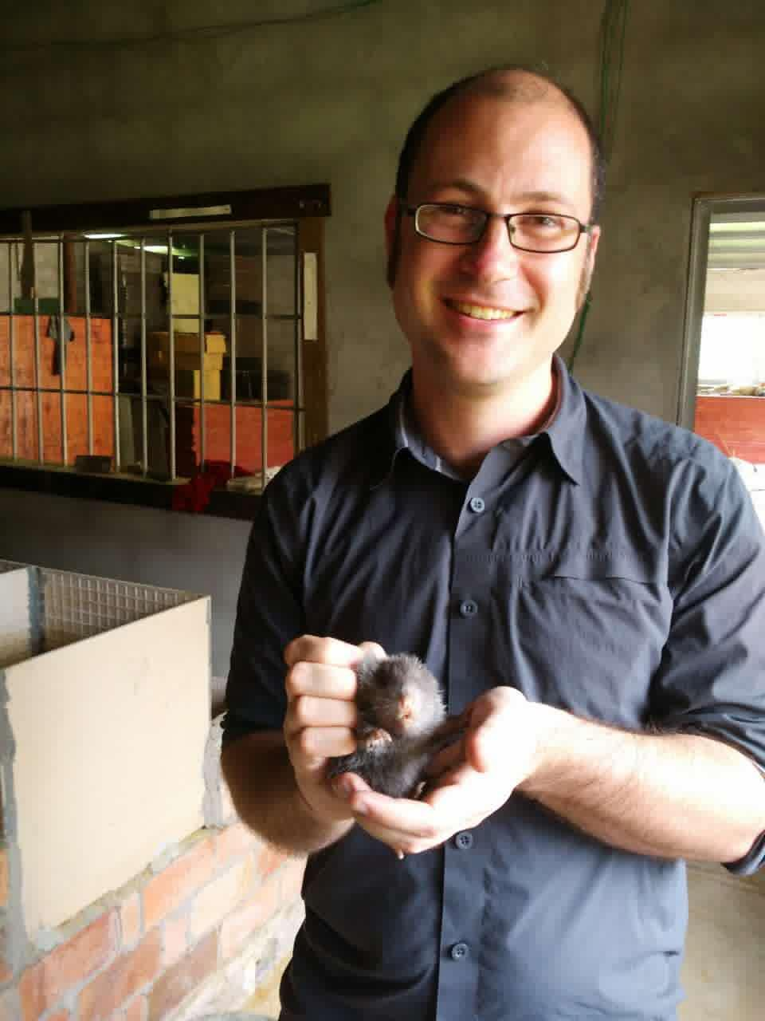
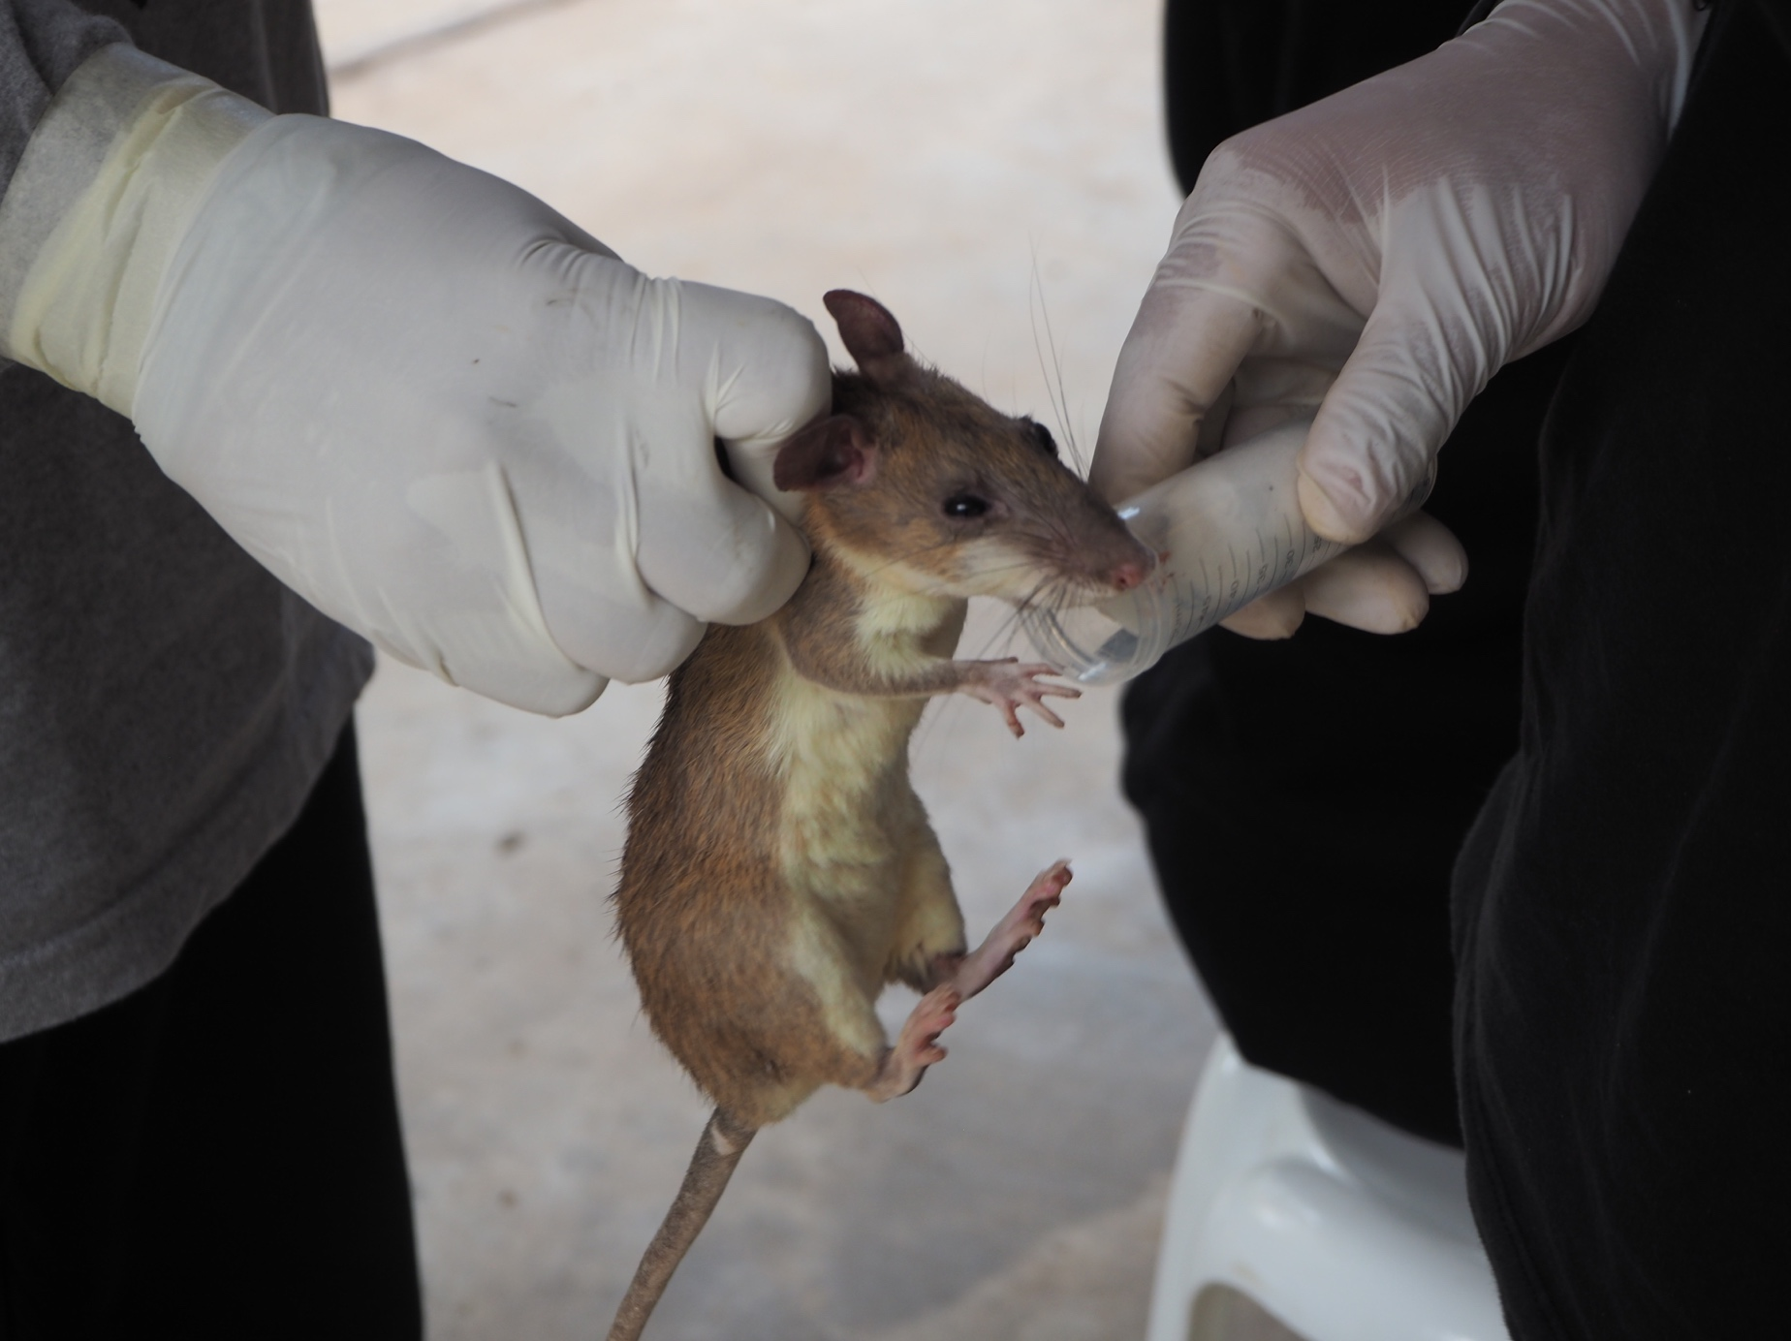
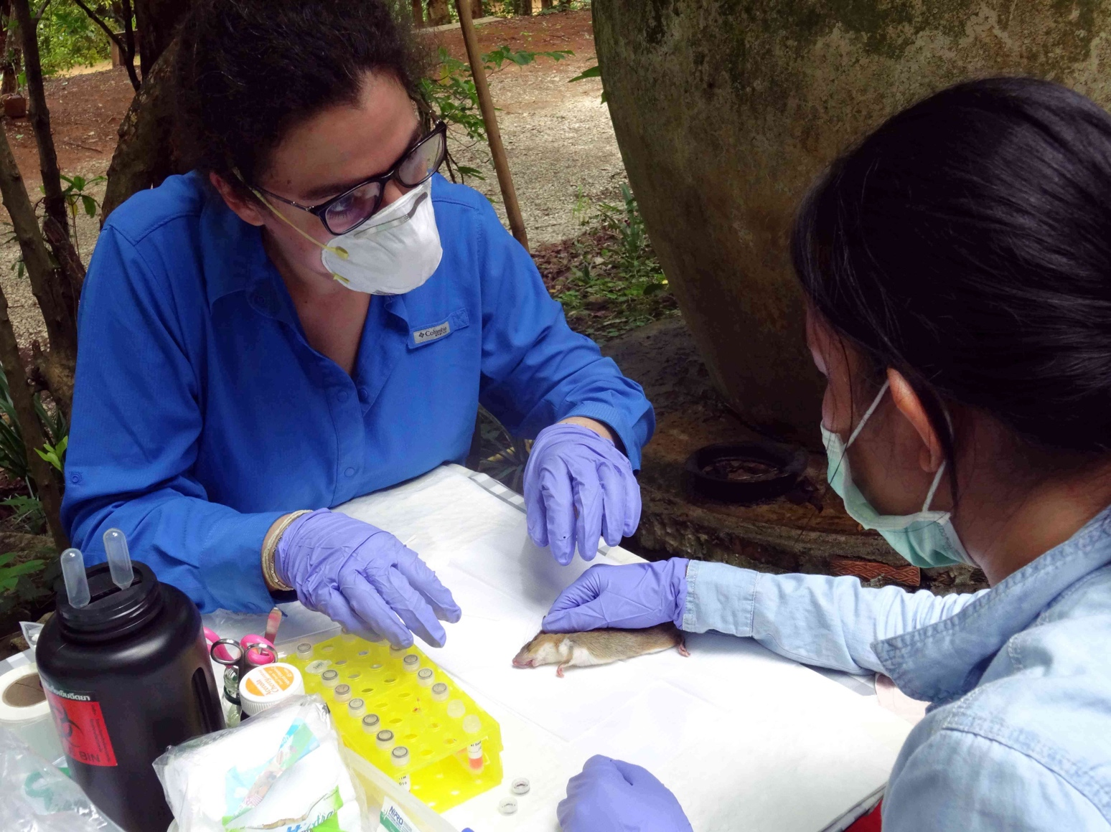
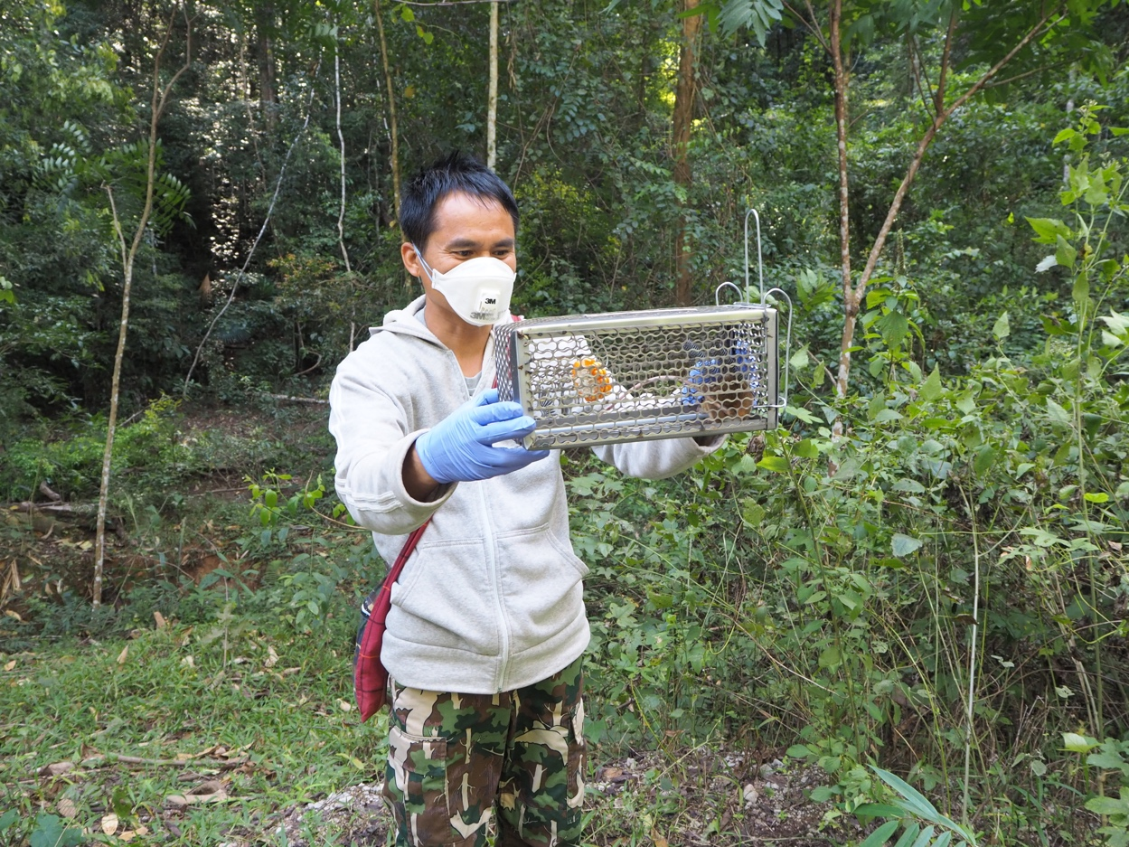

Slide 4
@EcoHealthNYC
@rOpenSci

Slide 5



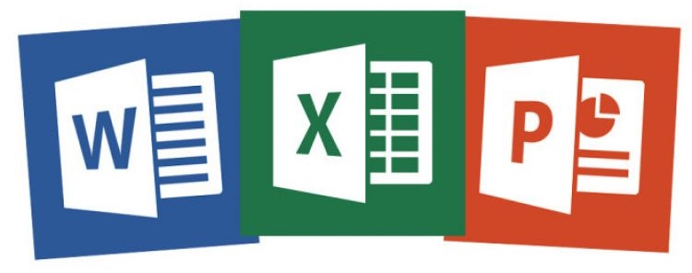
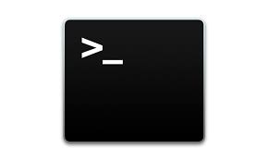


The Two Realms of Workflows

Slide 6
Valley of Heartbreak

Slide 7
Avoiding the Valley of Heartbreak
Reduce your round-trips
Make them as short as possible!

Slide 8
Web and programmatic outputs
Documents and further iterated outputs

Slide 9
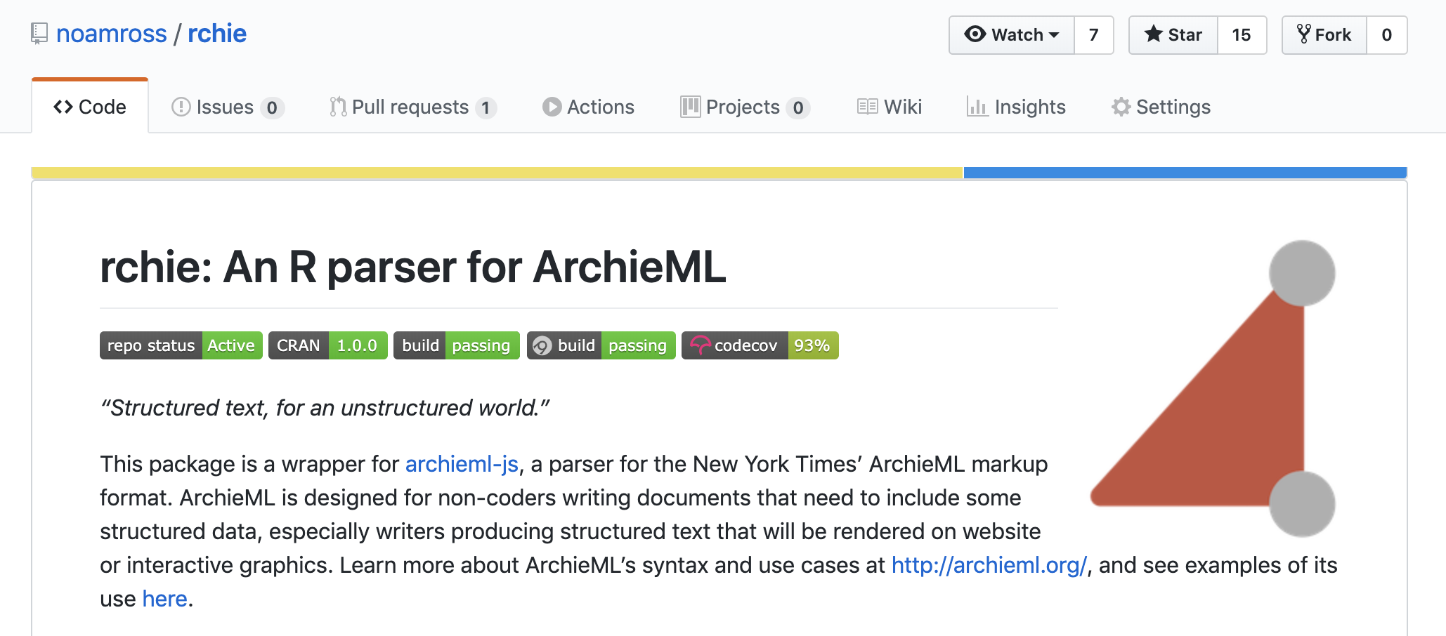
noamross.github.io/rchie

Slide 10
Web and programmatic outputs
Documents and further iterated outputs

Slide 11
The Officeverse / Gohelverse
officer
rvg
mschart
flextable
github.com/davidgohel/officedown
officedown:
David Gohel (@DavidGohel)
Notes:
mostly by David Gohel

Slide 12
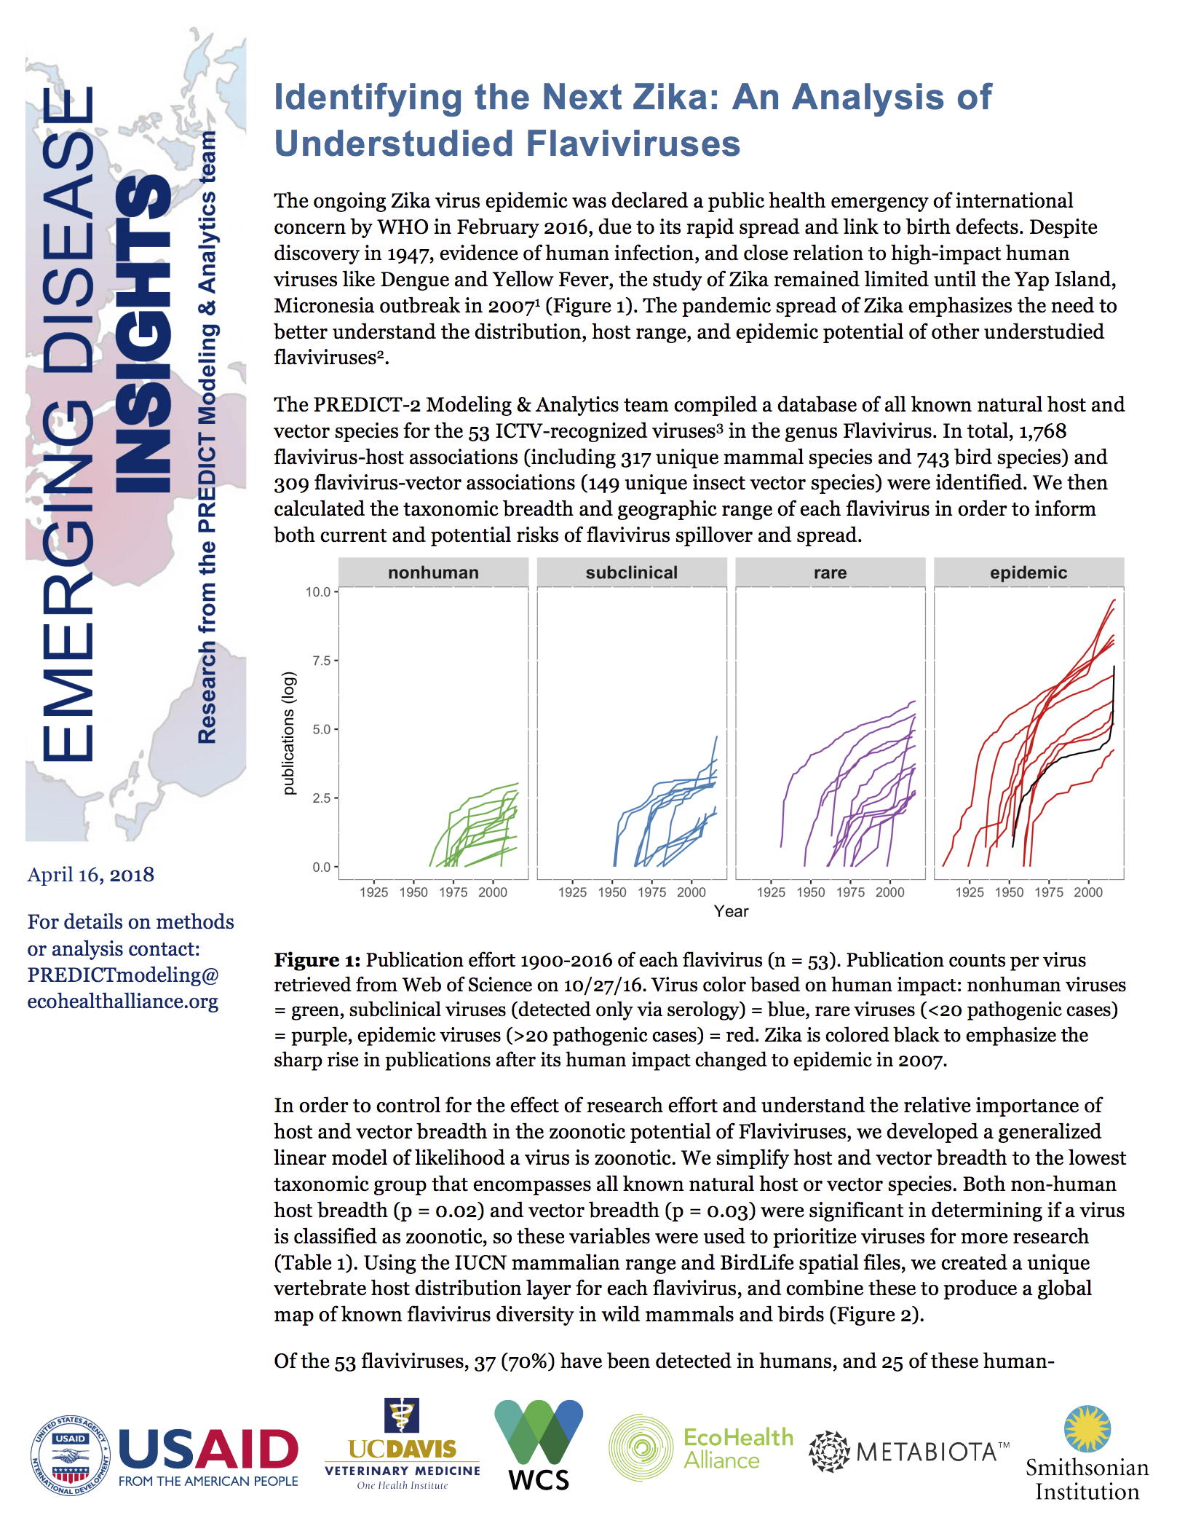
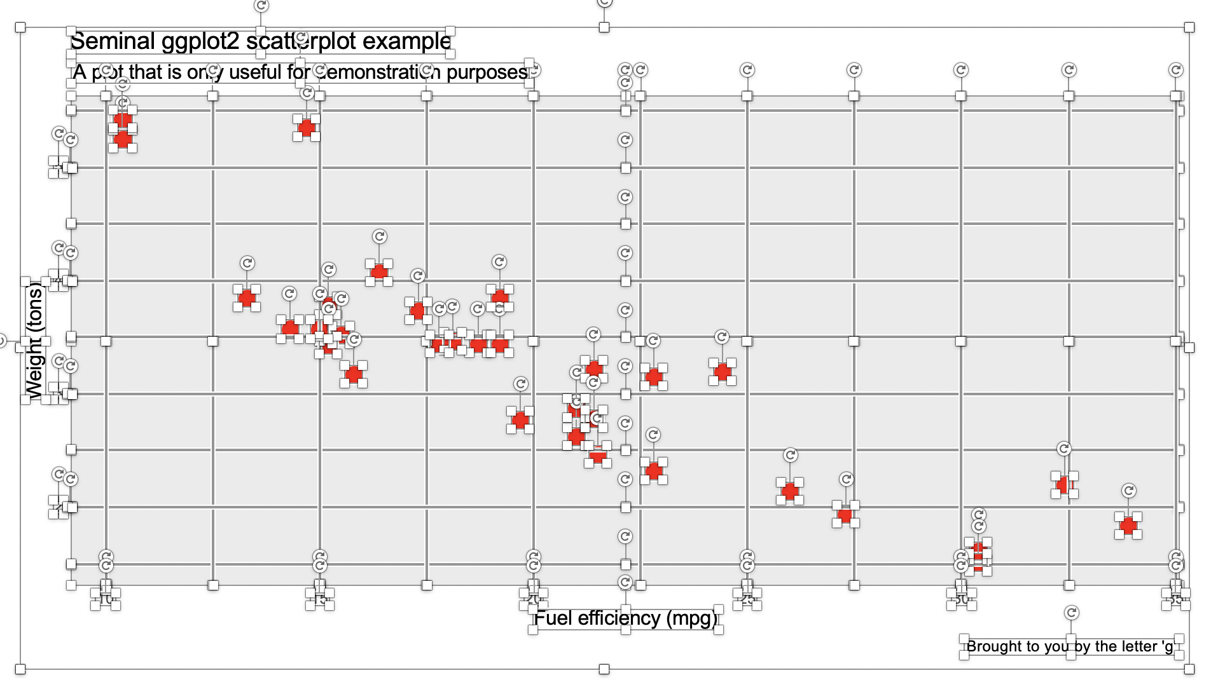

Slide 14
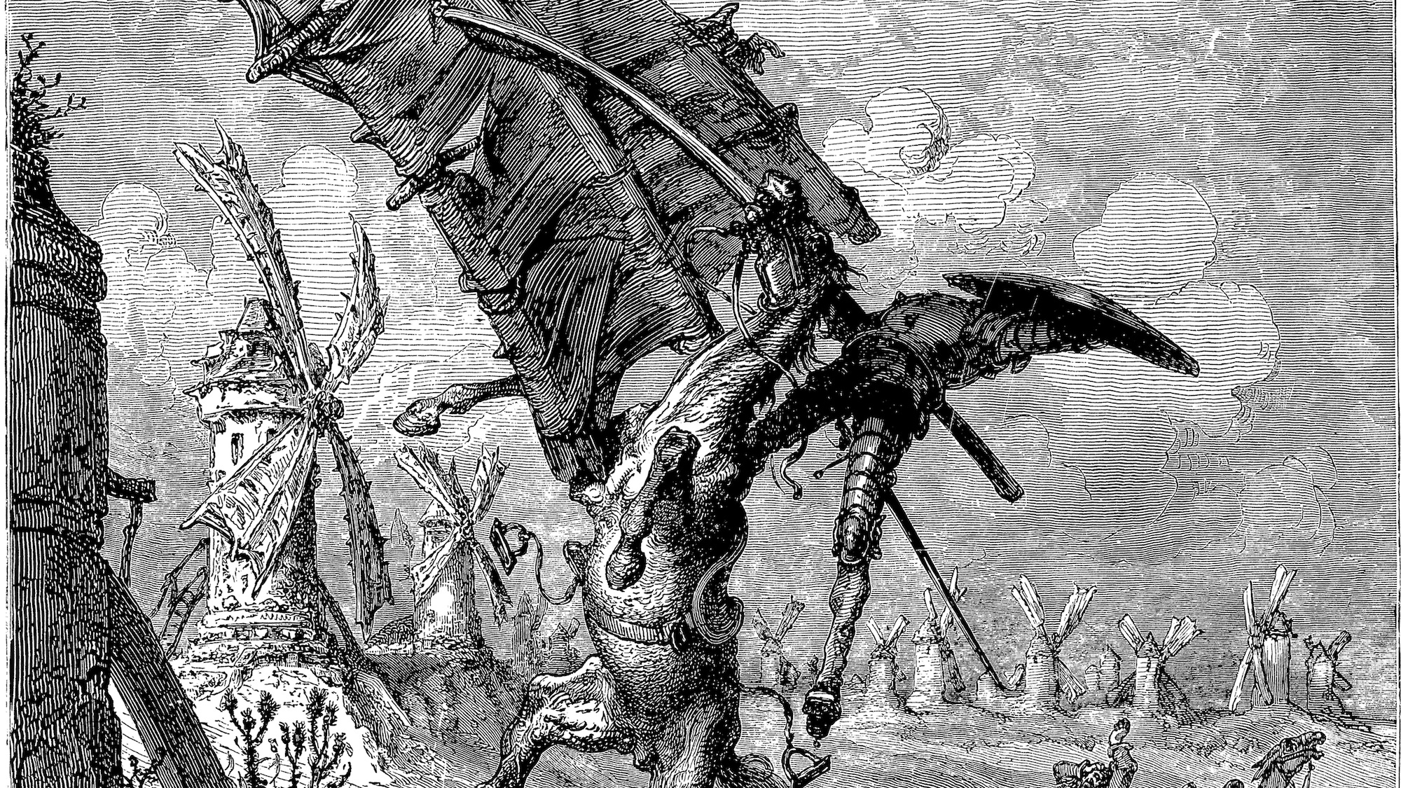

Slide 15
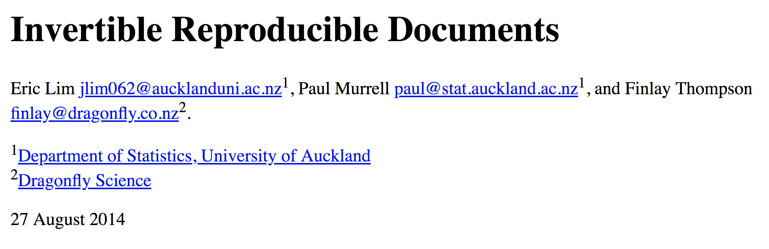
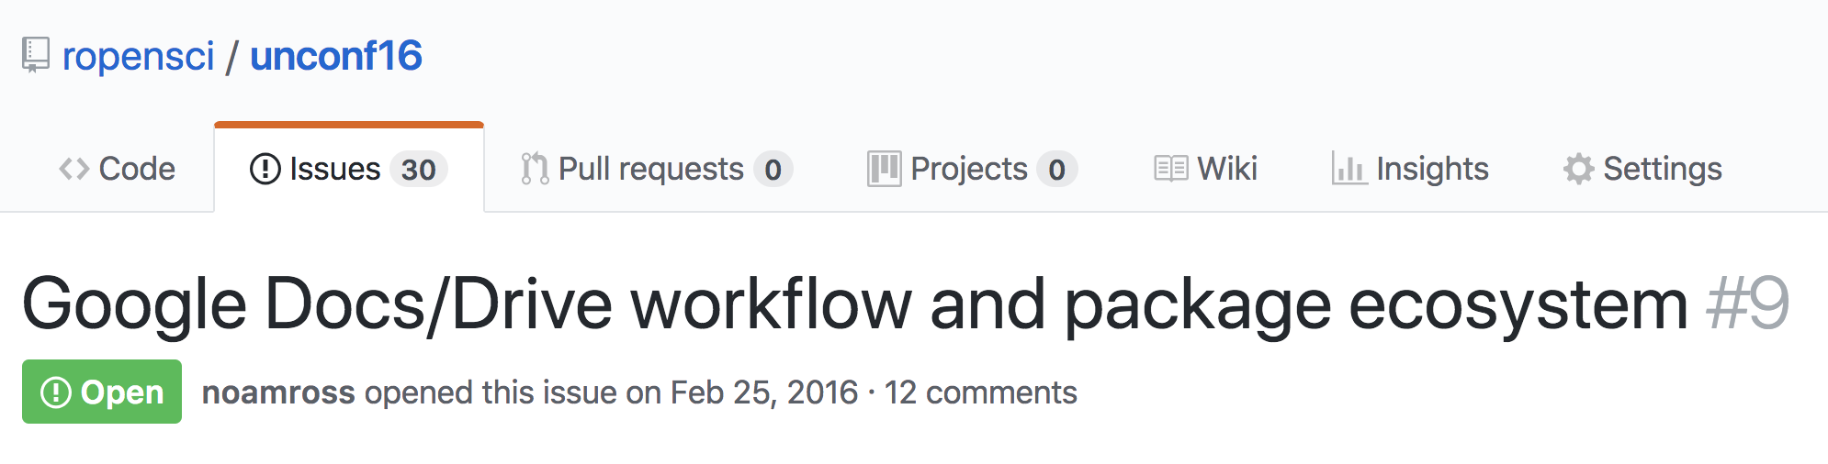
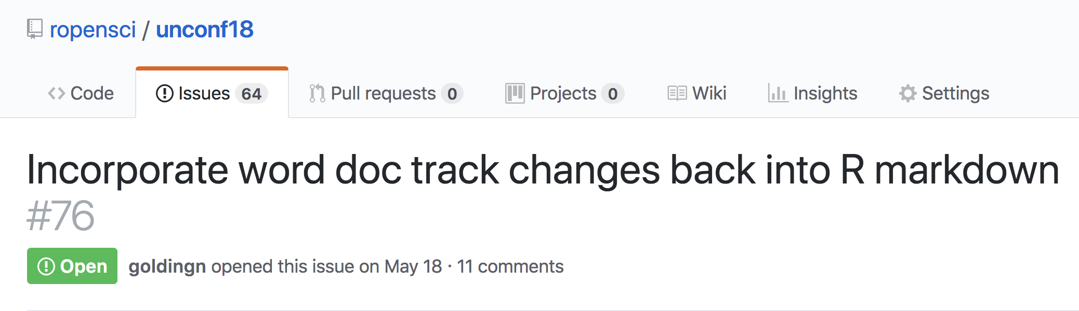
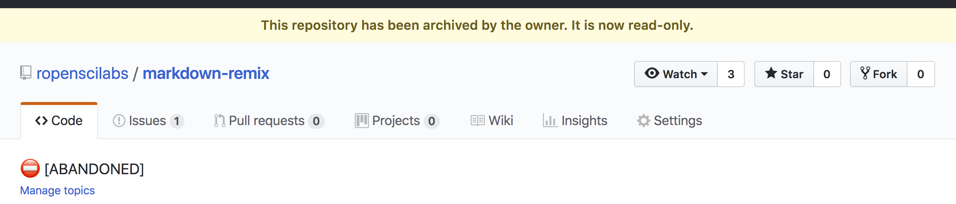
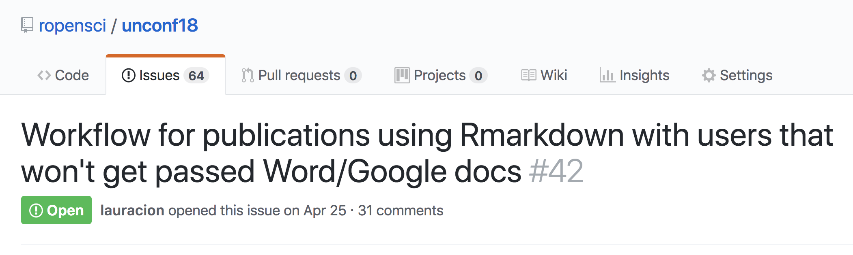
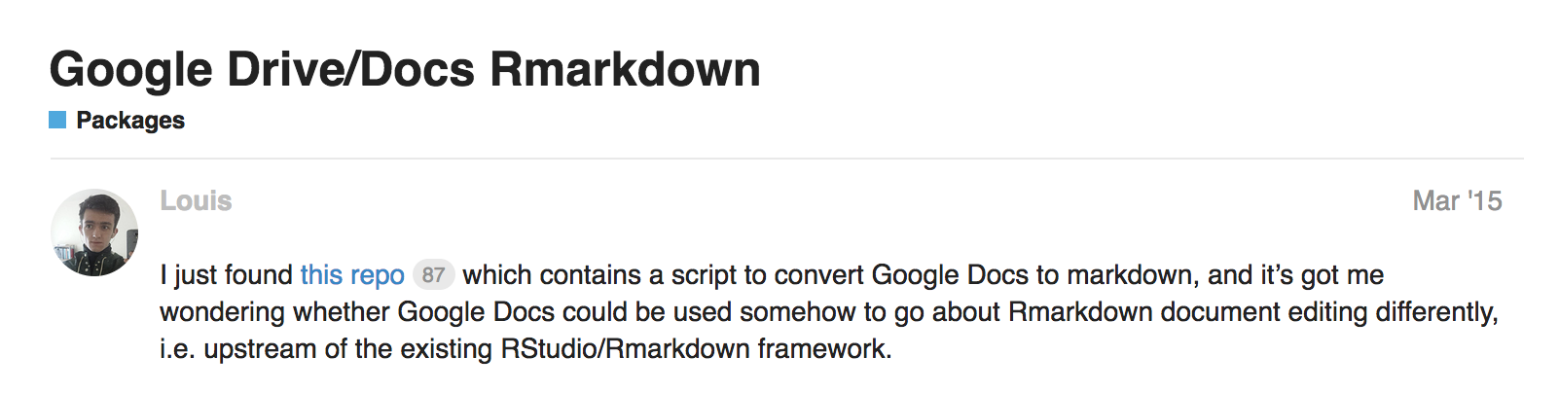
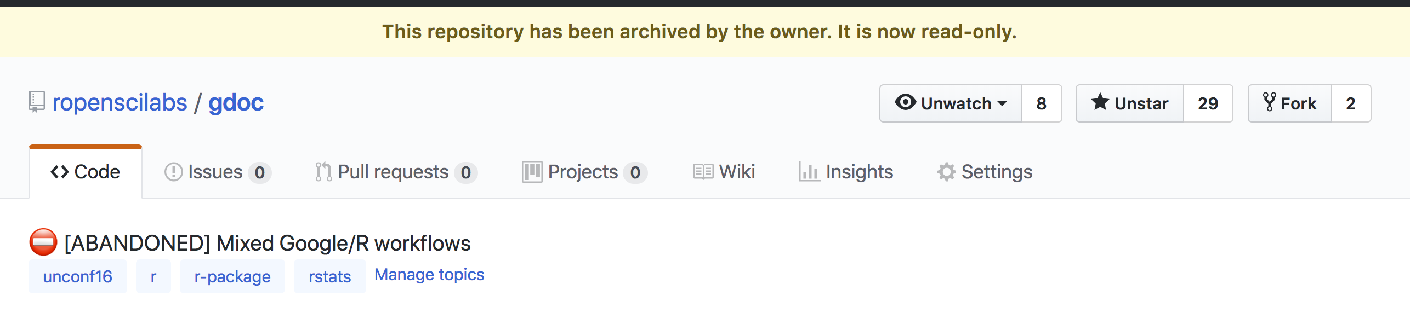

Slide 16
{ redoc }
📦
Reversible Reproducible Documents
noamross.github.io/redoc

Slide 17
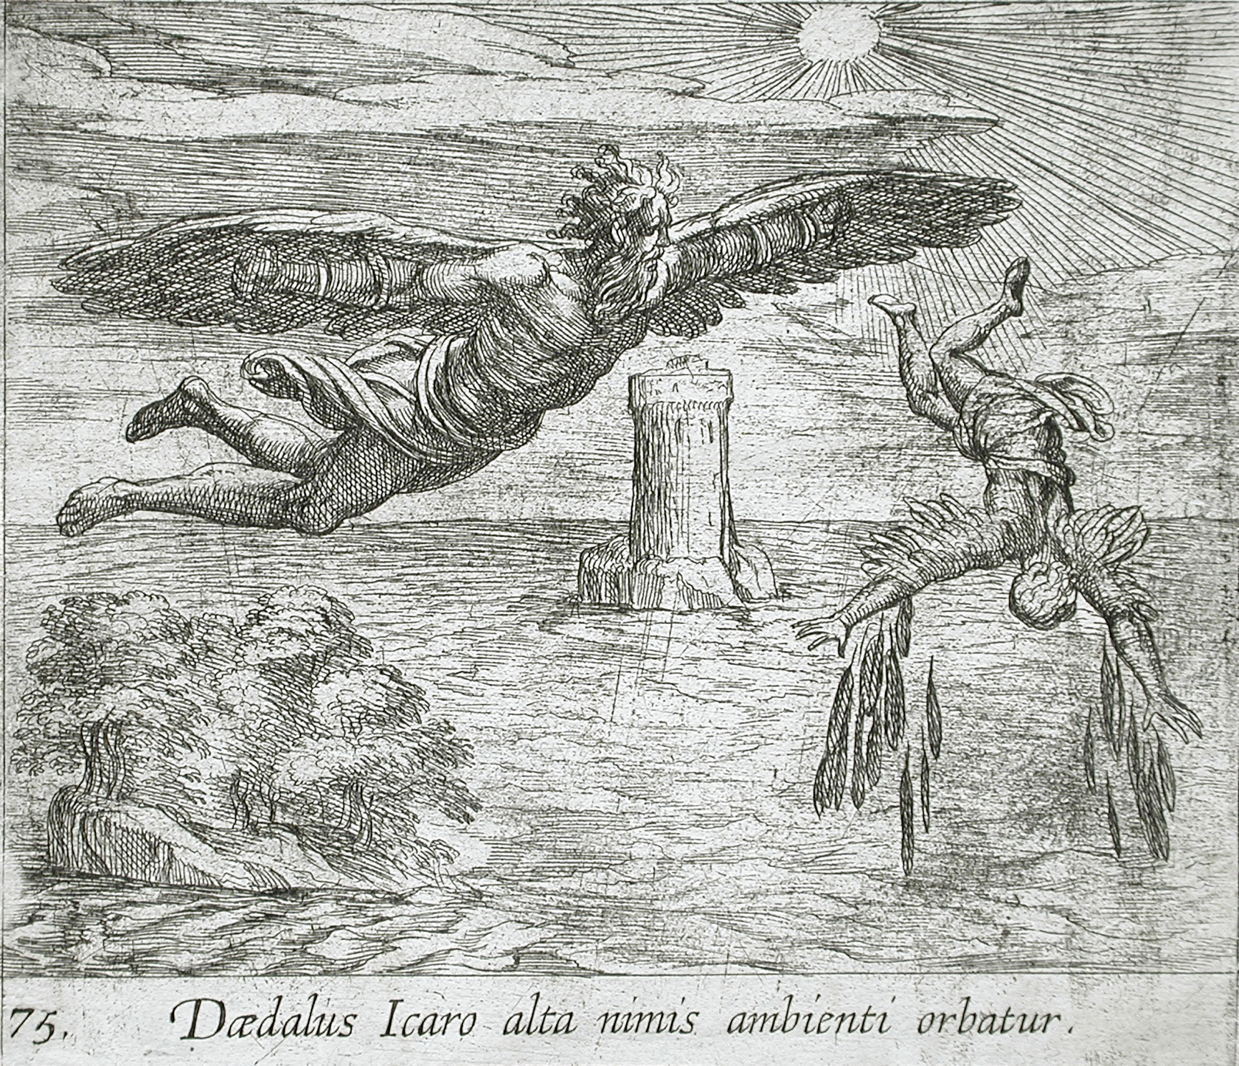

Slide 18
The road ahead for redoc
robustness and more edge-case testing
opinionated and sensible defaults
officedown and other format integration
citations?
Google Docs support?
noamross.github.io/redoc/CONTRIBUTING.html

Slide 19

Thank you!
And thanks to:
Yihui Xie+ (knitr, rmarkdown)
David Gohel (officer, officedown)
John Macfarlane (pandoc)
Brodie Gaslam (diffobj)
…and many more
@noamross
noamross.github.io/redoc

